Slide 1

Level Data Student Success Insight
AI Studio Final Presentation
Level Data 1B Team
12/04/2024
Notes:
Lisette
Welcome to our presentation on “Level Data Student Success Insight”

Slide 2

Introductions
Notes:
Lisette
Introduce the gray slides!
I will first introduce our wonderful team

Slide 3






Meet Our Team!
Jessica Lin UCLA
Zubeyda Farah SDSU
Kaelan Thouati de Tazoult UCLA
Lisette Gonzalez CSULA
Zuleyka Urieta Chapman University
Notes:
Lisette
Name, School, Major

Slide 4



Our AI Studio TA and Challenge Advisors
Dominic Diaz AI Studio TA
Eddie Shek Challenge Advisor
Pradnya Bhawalkar
Challenge Advisor
Notes:
Lisette
Dominic is our AI studio tutor and we worked closely with Eddie and Pradnya

Slide 5
Presentation Agenda
AI Studio Project Overview
Data Understanding
Data Preparation
Model Selection and Evaluation
Final Thoughts
Questions
Notes:
Jesijaicaijessica jesisiacJessica
Please raise your hand if you have any clarifying questions during the presentation! We will be going over a non-trivial amount of technical information, and we might not explain everything in enough detail in the interest of time.

Slide 6
AI Studio
Project Overview
Notes:
Lisette

Slide 7
“
Project goal: Identify actionable insights from historical student data for school administrators
Notes:
Lisette
Notes: What is the goal?
Our goal for this project is to identify meaningful features in the provided data sets that influence student success and be able to provide insights to schools about what impacts student success

Slide 8
Our Technical Goals
Develop a reliable predictive model for student success from educational data
Define an empirical metric for student success (“proficiency”)
Identify the key factors (“features”) that influence student success
Notes:
Lisette
Notes:
Our technical goals answer the following
How can we identify the key factors that influence student success and use this information to predict and improve outcomes for students?
To try to answer this our team decided we first we needed to determine a good metric to measure how proficient a student is and then, train a model to predict whether a student is proficient or not.
Our machine learning approach is supervised, meaning that we have to train the model using labeled data, where the input or features and output or outcomes are provided.

Slide 9
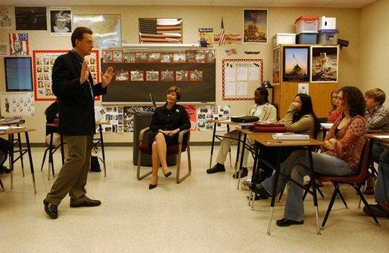
Business Applications of this Analysis
Optimize resource allocation
Inform interventions to support students
Evaluate different strategies to ensure continuous improvement
Notes:
Zuly
There are 3 main business applications of our analysis, the first being
Specifically with education services
Notes:
Be more clear
Audience is non-technical
Optimizing resources to make sure schools are getting the most of vendors
Justify the need for funding or investment

Slide 10

Ethical Considerations
Keep the identity of students anonymous for privacy reasons
Consideration of possible biases that the dataset may show in relation to race, gender, etc.
Notes:
Zubeyda
Notes:
To keep student privacy safe, we used anonymous data from real students in school districts and didn't include any personal info. Instead of focusing on individual students, we looked at trends based on groups for sensitive information like race and gender.
We also thought about how biases might affect the data.
For example, if some groups are underrepresented or don't have the same access to resources, it could impact their performance. By recognizing these bigger issues, we aimed to find trends fairly and see where certain groups might need more support without adding any biases to our analysis.

Slide 11
Our Approach
Data Understanding
Utilizing data visualizations to uncover patterns, trends, and potential inconsistencies.
Data Preparation/Model Exploration
Continue data preparation and manipulation techniques, look for models that will fit our data
SEPT
Nov
Choosing Model/Implement
Train model and generate predictions.Current limitations and future improvement.
AUG
OCT
Data Preparation
Select the most relevant features, perform thorough data cleaning, and data manipulation.
Notes:
Lisette
Notes:
We began by understanding the data, through visualizations
We then moved on to data preparation, here we performed some data cleaning and data manipulation
Then moved on to look for models that would fit our data
And finally we trained and generated predictions

Slide 12
Data Understanding
Notes:
Kaelan
So, let’s review the first step of our project, which was data understanding.

Slide 13

Data Overview
Anonymized District 18 data from 2023
Student data
Test scores
Attributes
Vendor usage data
District benchmarks
11,633 total students
Notes:
Kaelan
Notes:
Quickly, what did our data look like?
We had 700 of tests
The following attributes
Gender
English Language Learner
SpecialEd
LunchStatus
Ethnicity
The use of 45 vendor products
For the purposes of this presentation, vendor products are mostly digital education services that students use during the school day.
Essentially, this data should allow us to evaluate how a student’s attributes and usage of these products affects their test scores.

Slide 14
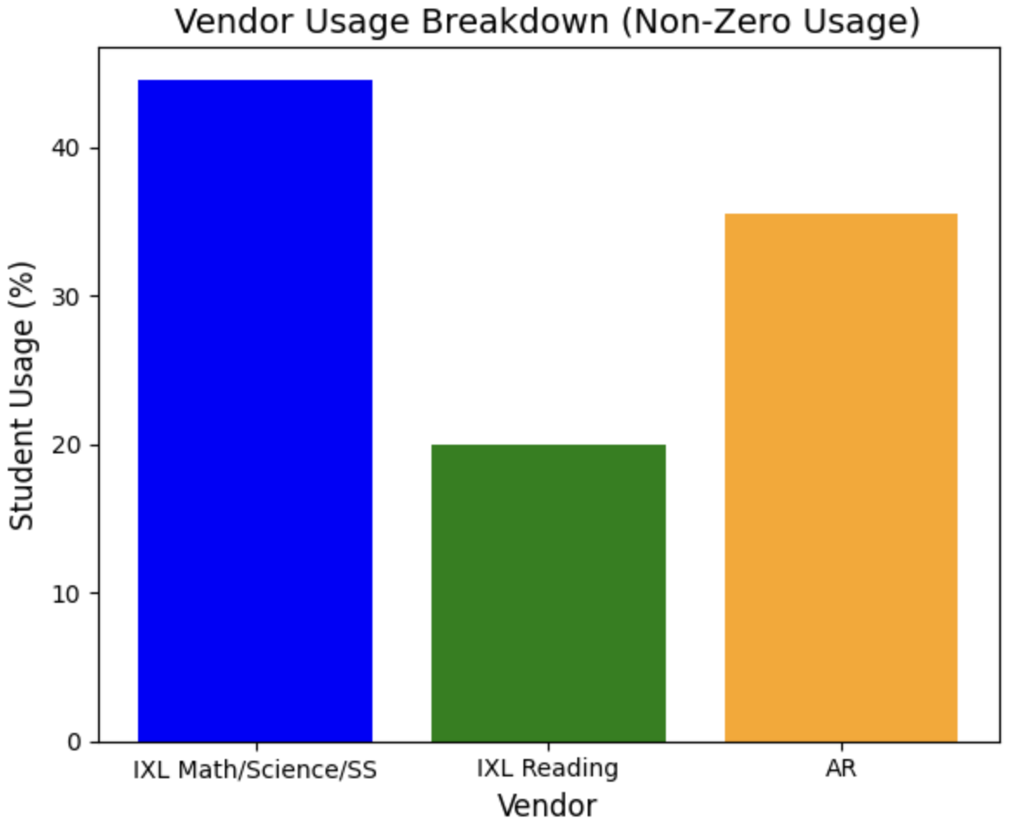
Visualization of Vendor Data
Breakdown of which vendors students use the most
The vendors most commonly used by students are for Math and English
Gives us an understanding of the subject categories
Each student is related to these products as a
Non-user
Partial-user
Full user
Notes:
Jessica
As shown in the graph, IXL Math/Science and IXL Reading dominate the usage. Math and reading are clearly prioritized, both in terms of testing and resource usage.
However, it’s important to note that these user definitions are loose. It’s unclear if whether a student is a partial/full user is consistent across classes, schools, or vendor products. It’s entirely possible that Student A in Teacher A’s classroom uses IXL math 10 minutes a day, and is a partial user, while Student B in Teacher B’s classroom uses IXL reading for 10 minutes a day, and is considered a full user.

Slide 15



Which vendors can we analyze?
Vendors products with significant data:
IXL Math
IXL Science
IXL Social Science (IXL SS)
IXL Reading
Accelerated Readers (AR)
Reflex Math
Notes:
Jessica
We only had enough data to look at ~65 tests, and the following vendors. A majority of the vendor usage was attributed to IXL, which as you all know is a prominent learning platform, as well as Accelerated Readers. We had to discard all other tests and vendors because there was either no data or not enough.

Slide 16
Data Preparation

Slide 17

Data Cleaning and Preparation
Removed NaNs (Not-a-Number)
Removed vendors and tests with insufficient student data
Arranged test scores and vendors by subject
Consolidated student scores
If students took multiple tests, we averaged their scores for the year
Transformed test scores into test z-scores, and then b-scores
Notes:
Zubeyda:Hello everyone! Today, I’ll quickly walk you through the key data processing steps for this project. We began by cleaning up the dataset, removing NaNs, which are (Not-a-Number) to address missing or invalid data and ensure reliability. Then, we filtered out irrelevant test scores and vendor data, focusing on what mattered most. A major transformation involved consolidating student scores into a unified format, though this required a significant assumption as we ignored measurement IDs for simplicity. Lastly, we standardized test scores by converting them to z-scores, enabling better comparisons across different tests. These steps streamlined the data, making it cleaner and more actionable for analysis.

Slide 18
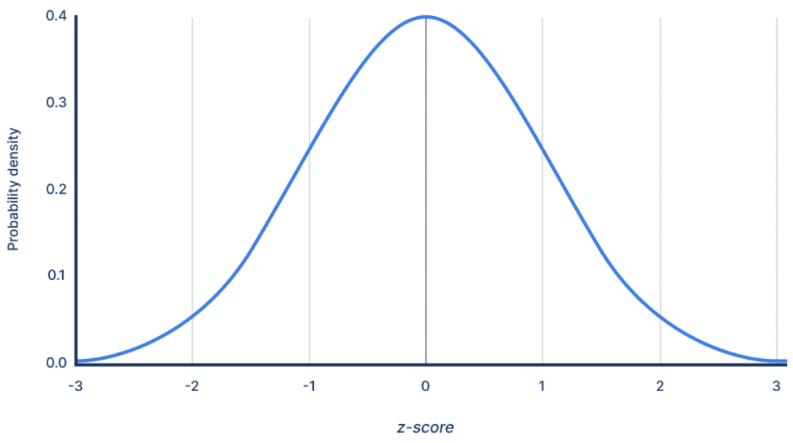
Z-scores
Ex. a student with a z-score of 1 is in the to the 84th percentile of students
What is a z-score?
Measures distance of a data points from the average of a group in standard deviations
Corresponds to a percentile value of a population
How it works:
Positive z-score means above average
Negative z-score means below average
Why z-scores?
Bring test results to a common scale
Allows us to compare test results with different scoring systems
Density
Z-scores allows us to tell how good students are relative to each other
Notes:
Zubeyda:"Let’s start with what a z-score is. Simply put, a z-score measures how far a particular value is from the average in a group of numbers. Think of it as a tool to help us understand whether a value is typical or stands out.
Here’s how it works:
A positive z-score means the value is above average, or higher than most other values in the group.
A negative z-score means the value is below average, or lower than most of the other values.
And a z-score of zero means the value is exactly average—right at the middle of the group.
So, in simple terms, z-scores help us determine where a specific value falls in relation to the rest of the data."
Notes:
They also highlight how students performed relative to their peers
We also change all of our scores to zcores.

Slide 19
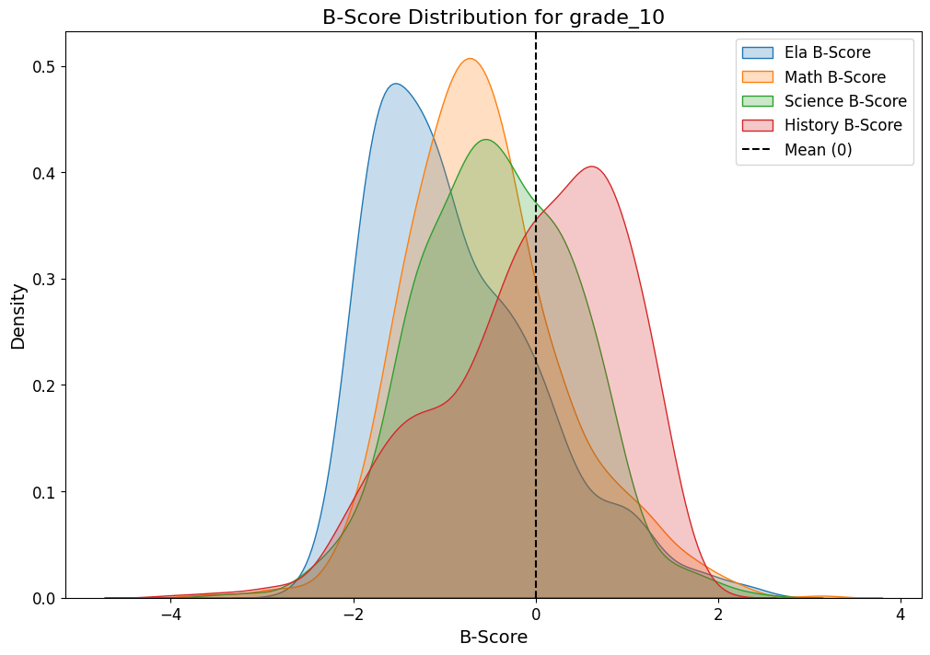
Artificial benchmarks and “b-scores”
Benchmark
b-score
Benchmark = “proficiency” cutoff for a test
For tests without benchmarks, we created our own benchmarks
Used benchmarks to calculate b-scores: z-scores oriented around benchmark instead of the mean
A b-score is the distance from a score and its benchmark
Density
z-score
B-scores are what we are trying to predict with our models
Notes:
Jessica :)
Since our goal was to predict if a student is proficient and why, it was necessary for us to have benchmark values for all tests, benchmarks being the cutoff for what score is considered proficient or not proficient
We didn’t have benchmarks for every test, so we created our own by taking the mean across that grade’s test values.
From there, we created b-scores, which is the distance between a test score and its benchmark in terms of standard deviations.
We wanted to use b-scores instead of z-scores because our goal of predicting whether a student is proficient or not is relative to the benchmarks
These new scores are what we are trying to predict with the models we are training

Slide 20
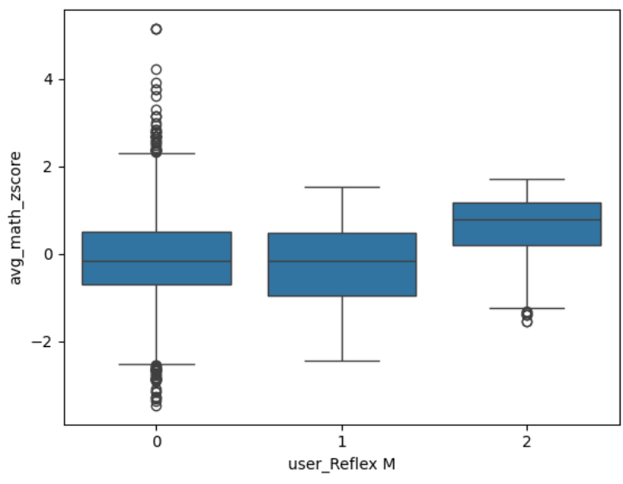
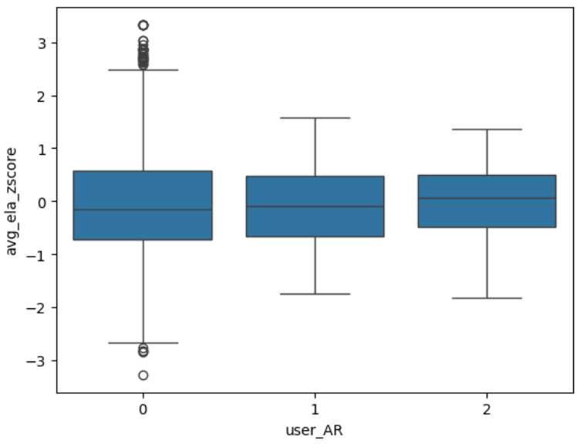
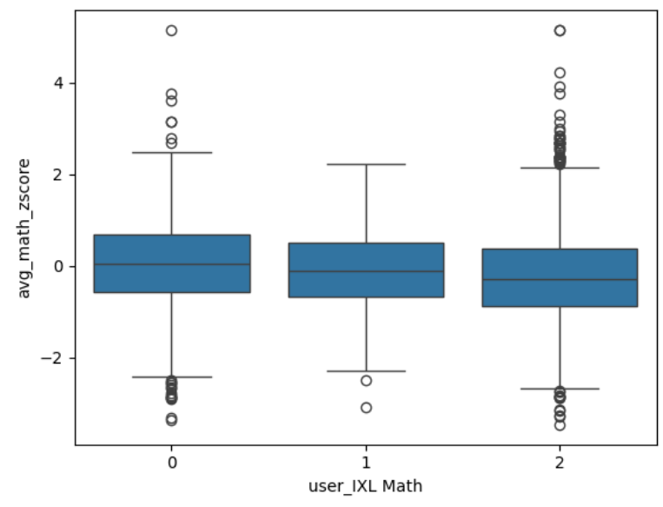
Before we model: Initial Correlations, what might we expect?
Linear Correlation: +3.5%
Linear Correlation: +1.94%
Notes:
Kaelan
Before we make our models though, it is helpful to do a preliminary analysis of our data. We ran a simplistic linear correlation test on each product to how it affected its subject. Here are some box plots of vendor usage data by related student subject z score. For example, on the left here, we see that non users and partial users of Reflex Math tend to do slightly worse than full users of Reflex Math.
In these examples, these products had a very very slight positive linear correlation with the their respective tests.

Slide 21
Vendor Product Breakdowns
Vendor Product | Subject Proficiency Correlation
Reflex Math | +3.5%
IXL Math | -13%
IXL Science | -0.0048%
IXL Social Studies | +2.8%
Accelerated Reader | +1.94%
IXL Reading | -6.58%
Notes:
Kaelan
Notes:
Here are all of the vendors and their correlation values. You can see here, the correlation is never strongly negative, and IXL seems to generally do worse than other vendors. It is important to note that this is very limited assessment, and should not be taken as an official test, this just gives us a litmus test to compare with our future models.
Why this is a very limited assessment
It treats all students as equal, regardless of gender and grade level
Linear correlation is an imperfect metric in general, but especially here, because our X_axis only spanned [0,2], while our y axis spanned [-6,6]

Slide 22
Modeling & Evaluation
Notes:
Zuly :)

Slide 23
Model Comparison
Model Name | Description | Pros | Cons | Metric Used for Model Evaluation
Logistic Regression | Finding relationships of data factors | Passing/Not Passing Interpretable results | Struggles with imbalanced data | Accuracy
Decision Trees | Breaking a prediction/ decision into smaller decisions | Interpretability Little data prep Flexibility | Prone to overfitting High variance | Accuracy
Notes:
Zuly :)
Now we will be moving onto modeling and evaluation.
From our data understanding and goal of predicting student proficiency, we landed on 2 different models to move forward with that.
This table compares the these models: logistic regression and decision trees
Let’s start off with logistic regression. This is a model the finds relationships of data factors. The pros of this model its ability to have a clear indication of whether a student is passing or not passing
In the context of logistic regression, "passing" and "not passing" represent a binary outcome, where "passing" is typically coded as 1 and "not passing" as 0, making it a perfect application for predicting binary outcomes based on predictor variables; essentially, the model estimates the probability of a student being proficient in this case given certain characteristics.
This type of model also provides results that are easy to interpret. Yet the cons are that it struggles with imbalance data.
Moving onto decision trees, this model essentially breaks down a prediction or decision into even smaller predictions.
The pros of this model are that the model is easily interpretible, requires little data prep, and is flexible.
Yet it;s cons are that it’s prone to overfitting and has high variance.
Overfitting occurs when a logistic regression model becomes excessively complex, capturing not only the true patterns in the training data but also its random noise, leading to poor performance on new, unseen data. This situation is characterized by high variance, meaning the model's predictions are highly sensitive to small changes in the input data.
We are evaluating both models using accuracy, which is essentially the percentage of times the model gets the answer right

Slide 24
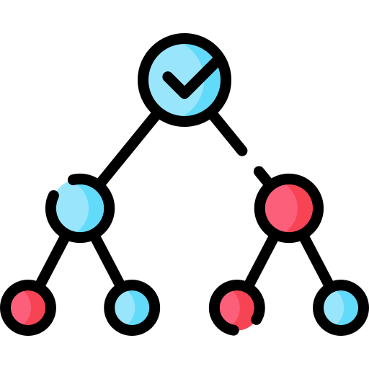
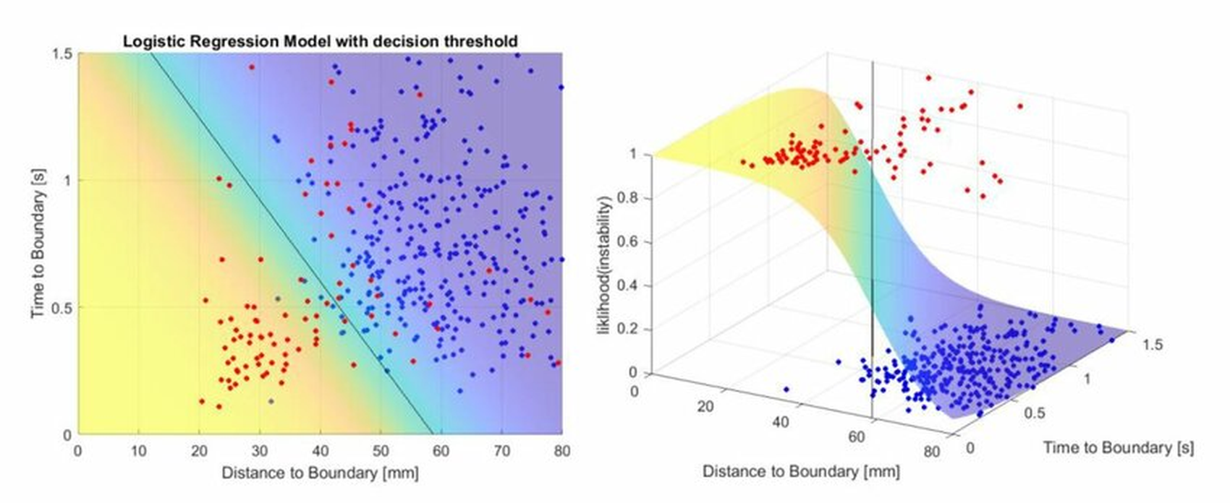
What do these models do?
Logistic Regression Classification
Analogous to linear regression, defines a probability function.
Flexible to non-linear relationships, and is better suited to classification.
Decision Tree
Breaks down final prediction into simply yes-no comparisons on individual features. Essentially a flowchart.
Notes:
Kaelan
Notes:

Slide 25
What are we training our models on?
Products will affect different students differently.
We divided our data by school levels:
Elementary
Middle
High
Within these datasets we further divided the data by gender:
Coed
Female
Male
30% of the data is reserved for validation and testing model performance
On each subgroup we made the following models
Logistic Regression
Decision Trees
Each model has a binary and multiclass variant.
Total of 144 models
Notes:
Jessica
It is unrealistic to assume that products will affect all students equally. We will split our data sets into smaller, more homogeneous groups and run individual models on these populations to cover our bases.
We divided our dataset by levels, gender and then by subject
This allowed us to further analyze how or if vendor usage affected subgroups differently
For each subgroup, we made both logistic regression models and decision trees, as well as binary and multiclass variants for a total of 144 models.

Slide 26
Our Models
Notes:
Zuly :)
Now that we’ve briefly covered the two types of models we moved for

Slide 27
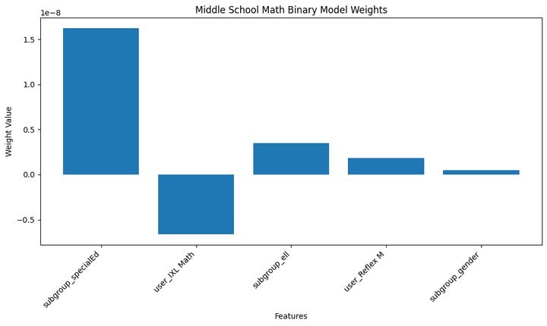
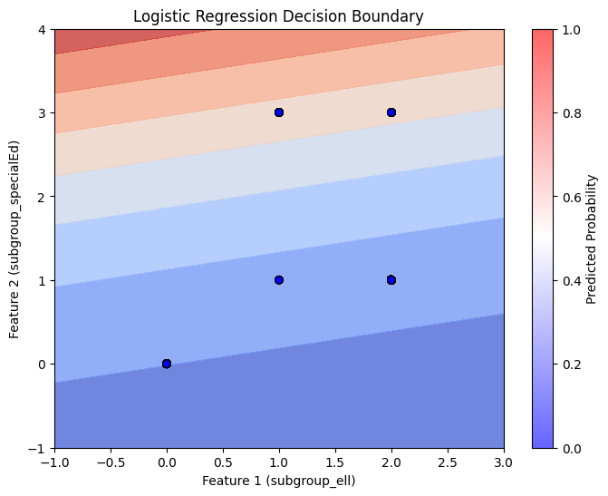
Logistic Regression Visualization
*ell = English language learner
Notes:
Zuly :)
Notes:
Looking at our visualizations of logistic regression, on the left hand side you will see a graph of Binary middle school model weights
These weights show how much each factor (like special education status or using a math program) influences the model's decision, with larger weights increasing the likelihood of a certain outcome and smaller weights decreasing it.
The graph at on the right is a decision boundary graph that is actually illustrating a simplification of the model that we created since it is only showing 2 out of the 5 student characteristics. The two considered in this graph are whether they are English Language Learners or in Special Education—and predicts whether they will be proficient. On this graph, the dots in the blue area represent students who are not proficient, and the dots in the red areas represent where the model thinks students are more likely to be proficient. The model did okay but might need more information to predict better for all students (which is where the other features come in!)

Slide 28
The verdict of this model:
How confident are we in this answer?
Neither IXL Math nor Reflex Math are favored by the model.
These results are generally consistent across gender and school.
According to this approach, IXL and Reflex Math are not effective at raising math test scores in students.
Our metric: Prediction Accuracy
What percentage of guesses were accurate to the ground truth?
Accuracy of this model: 71-75% (variance from random split)
This accuracy is considered good performance for a binary classifier
But, as we will later discuss, this model is limited.
What percentage of guesses match the ground truth?
Notes:
Zuly
Now what was this verdict of our logistic regression model? We created both binary and multi class models and we concluded that
Note: Restructure the slide format
70%?
Sample model but the other models showed similar results (2nd bullet)

Slide 29
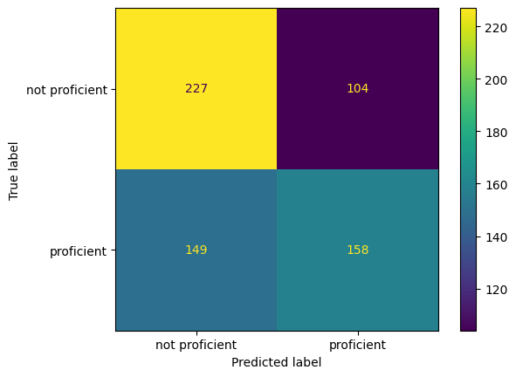
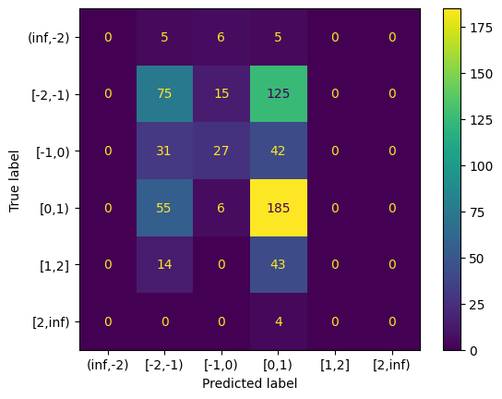
Confusion matrices: detailed accuracy analysis
(true negatives)
(false positives)
(true positives)
(false negatives)
(true positives)
Figure 1: Math binary logistic regression matrix
Figure 2: Math multi-class logistic regression matrix
Notes:
Kaelan
Let’s look at our accuracy in a little more detail. On this slide we have two confusion matrices, which plot out what our predictions looked like compared to the ground truth.
There were two labels that we predicted. On the left here we have a binary classifier, which predicted if a student was proficient or not in a subject, and we also had a more granular classifier which essentially guessed how proficient a student was.
Here is an overlay of what these numbers end up meaning. We see that we were about as good at guessing positive cases as we were negatives for the binary classifier, and our multiclass classifier trained on the same dataset, when it guessed wrong, clustered its answer around the true positive line.

Slide 30
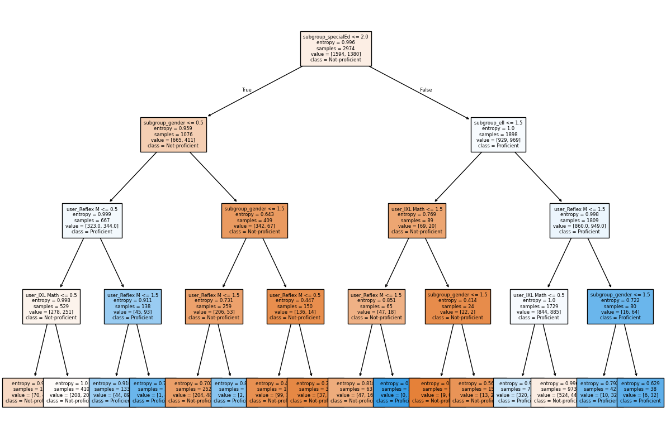
Decision Tree Visualization*
*note: this is a simplified version of our final model for this subpopulation
Math proficiency binary decision tree (depth=4)
(elementary school co-ed population)
Notes:
Kaelan
Notes:
Now that we’ve taken a look at a sample from our logistic regression models, let us take a look at a sample decision tree. This here is a visualization of one of our decision tree models. Don’t squint too hard at it, we’ll have a much closer look at it.
subgroup_specialEd <= 2.0 -> It means that the data is split based on whether the feature subgroup_specialEd has a value less than or equal to 2.0.
Entropy = 0.996 -> Entropy measures randomness, a value closer to 1 means the data is almost equally mixed between Not-proficient and Proficient, but if it is closer to 0 then we would have for example more Proficient students
Samples = 2974 -> total number of data points that reached this node
Value = [1594, 1380] -> tells us how the samples are distributed between the two classes (Not-proficient, Proficient)
Class = Not-Proficient -> this is the majority class at this node so 1594 = Not-proficient will be predicted for this node.

Slide 31
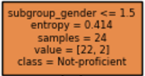
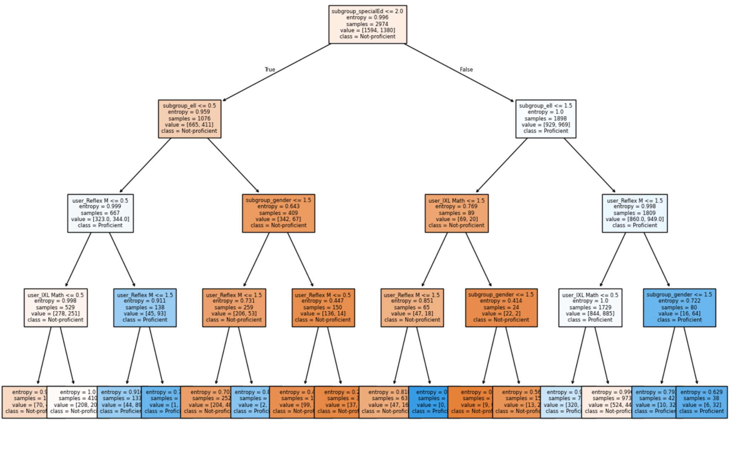
To read this visualization, we only need to pay attention to two elements of any node:
Comparison: If this student meets this criteria, continue down the left path.
Entropy: How confident the model in this particular decision
Entropy close to 0: high confidence
Entropy close to 1: low confidence
*
If true, Result 1
If false, Result 2
*
If student is male
Notes:
Kaelan
There are a lot of ways to analyze how models like these work, but for the purposes of this presentation, we only need to pay attention to two elements of any node.
Taking a closer look here at a sample node, we see two elements: the true-false comparison that the tree is making, and how confident the tree is in the effectiveness of this particular decision. In this case, the tree asks “is this student male? If yes, proceed down the left path, else, proceed down the right. An entropy close to 0 is good, it means the tree is confident, and an entropy close to 1 is low confidence.
Usually if a model has low confidence in one of its choices it means that there is only a weak correlation between the comparison we are making and the result. In high entropy examples, the delineation of the data due to this comparison is fuzzier.

Slide 32
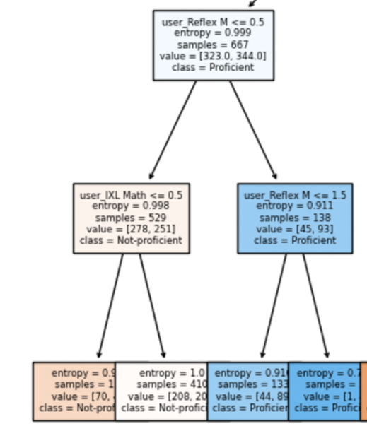
So, how is our tree making decisions?
Extremely high entropy in regards to vendor features:
Partially due to the simplicity of this example
Mostly due to a weak correlation
Other Relevant Entropies
Reflex Math Entropy: 0.999
IXL Math Entropy: 0.998
Reflex Math Entropy: 0.911
Reflex Math | 0.447*
 | 0.773
 | 0.815
 | 0.998*
IXL Math | 0.679
 | 1.00
Notes:
Kaelan
So, we are interested in the nodes that make comparisons with the user status [arrow]. In the tree we just looked at, here were some sample nodes that contained vendor usage comparisons, which are really what we are interested in. Normally, we could follow where the nodes go, but if we take a look at the entropy values, we see that they tend to be pretty high, which means the model tends to not really know what it is doing with these usage data.

Slide 33
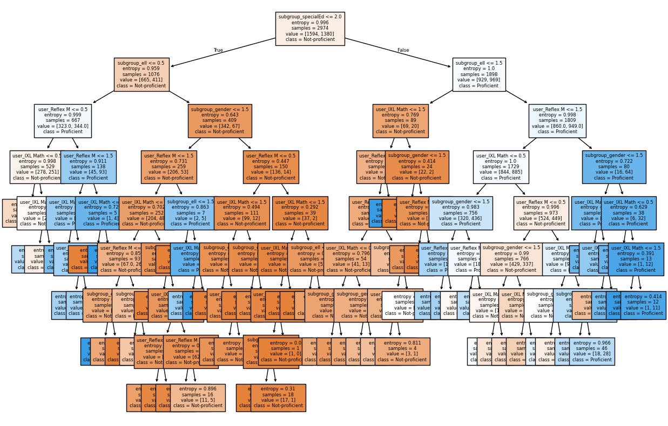
Notes:
Kaelan

Slide 34

Entropies for our final model
How confident are we in this answer?
Reflex Math | IXL Math | Gender | English Language Learner
0.984437 | 0.981011 | 0.977214 | 0.892146
0.941888 | 0.976392 | 0.801537 | 0.805827
0.966224 | 0.940067 | 0.786892 | 0.95036
0.920494 | 0.929348 | 0.545753 | 0.475646
0.916163 | 0.391229 | 0.791718 | 0.907828
0.905114 | 0.965557 | 0.986051 | 0.851411
0.948825 | 0.948971 | 0.9862 | 0.769584
0.760768 | 0.460836 | 0.934555 | 0.460836
0.894252 | 0.934337 | 0.914018 | 0.993736
0.892146 | 0.906757 | 0.911952
0.701773 | 0.856994
0.993466 | 0.841203
0.974902 | 0.918602
0.974648 | 0.878682
0.988775 | 0.475646
 | 0.993201
 | 0.97345
 | 0.976405
 | 0.958026
 | 0.852758
 | 0.693998
 | 0.845337
 | 0.685255
 | Reflex Math | IXL Math | Gender | English Language Learner
Average Entropy | 0.91759166 | 0.842785 | 0.86358 | 0.7897082222
The Verdict:
The model sees it’s decisions due to vendor usage to be not very predictive
IXL Math and Reflex Math are not shown to impact student success
Accuracy of this model: 70-74% (variance from varying the random split)
Notes:
Kaelan

Slide 35

Overall findings for math products
(We repeated this experiment across schools and gender subgroups and achieved similar results)
Reflex Math and IXL Math usage are not shown to be predictive of student student math proficiency according to
Linear Correlation
Logistic Regression
Decision Tree Classifiers
We do not recommend the use of these vendor products for improving student success.
Notes:
Kaelan

Slide 36
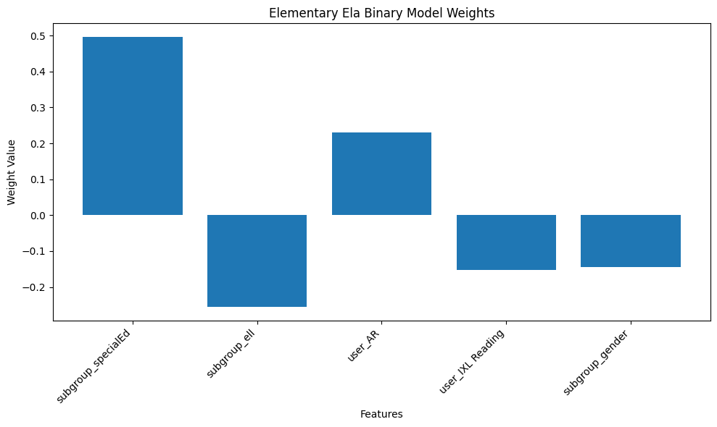
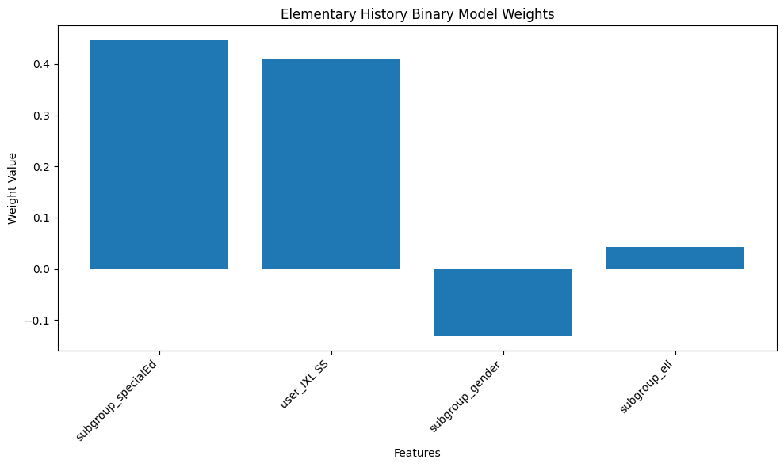
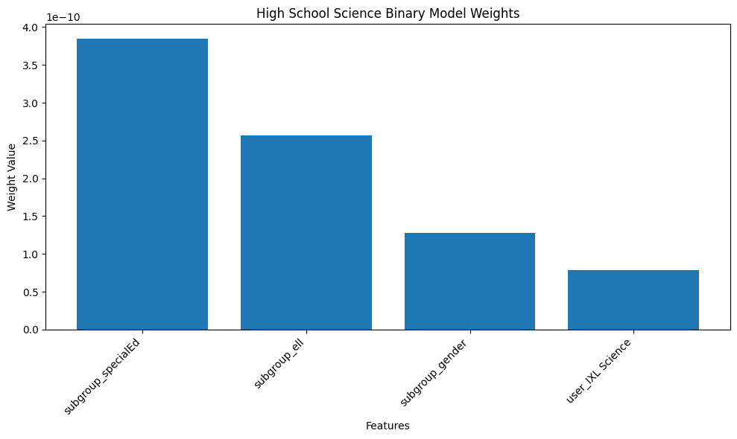
What about our other products?
Logistic regression models for other vendors returned similar values for their respective subjects
Vendor products consistently do not outperform other features
= vendor product weight
*
*
*
Due to smaller datasets for these subjects, these models were harder to fit. We are less confident in these models.

Slide 37
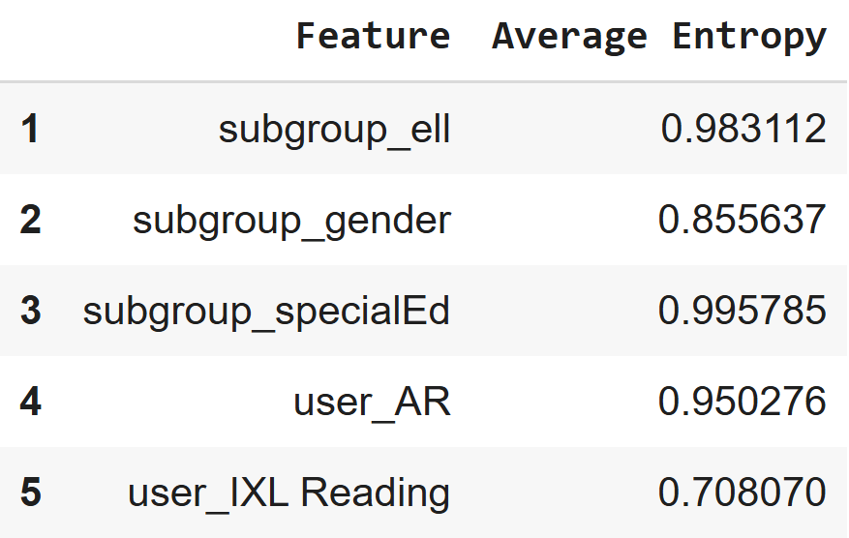
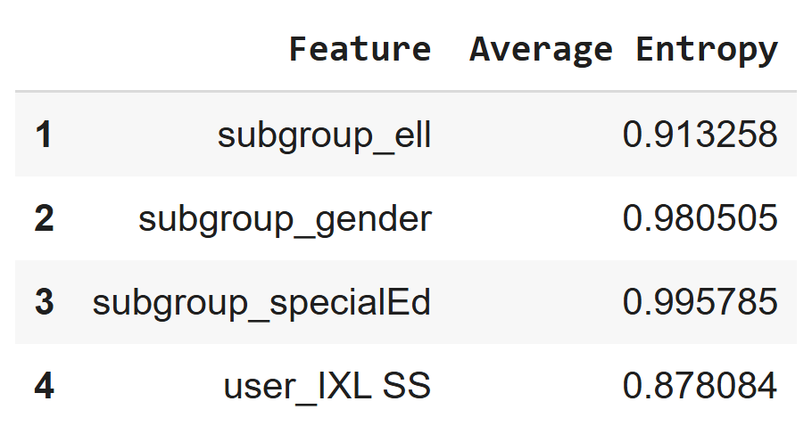
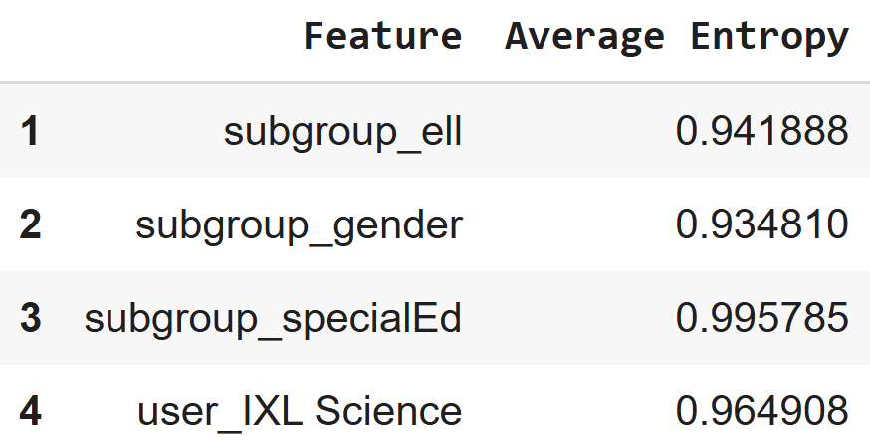
What about our other products? cont.
Similarly, decision trees for other vendors had comparable average entropies
Vendor products consistently do not outperform other features in predictive value
Possible exception - when investigated in detail, the model does not consistently point to either proficiency or lack thereof. This is still not a predictive feature for this model.
*
*
*
Due to smaller datasets for these subjects, these models were harder to fit. We are less confident in these models.

Slide 38

Final Results
With the data provided, we did not find significant predictors of student success from usage of the given vendor products.
Consistently, across multiple model types, label types, and populations, the students of District 18 were not shown to benefit from the use of vendor products.

Slide 39
Final Thoughts
Notes:
Zuly

Slide 40
Data Expansion and Model Improvements
Improving Predictions
Considering exam time relative to vendor usage
Using vendor use in the previous year
Getting more granular data for vendor use
Weekly Vendor Usage Minutes is a metric that Level Data has started collecting
Repeating this exercise on larger data sets
Even our best model were trained on < 3000 examples.
Model Optimization
Regression models may train better on this data
Ethical Considerations
Populating subgroup data
Race and socioeconomic status especially
Fully populate gender data (>50% of gender data unpopulated)
Notes:
Lisette
Notes:
We can expand our data and improve our models in a few different ways:.
To Improve Predictions:
We considered the relationship between the timing that students took exams and their vendor usage, but due to limited information we could not make correlations between them.
Access to vendor usage from the previous year would offer valuable insight, that could help us identify patterns that may impact outcomes.
To refine our analysis, we could explore more granular data on vendor usage. For instance, Weekly Vendor Usage Minutes, a new metric recently introduced by Level Data, could give us deeper insights.
If we repeat this process on larger datasets it would improve model accuracy and scalability. Our current best model was trained on less than 2000 examples, which is more on the smaller size
Now, for Ethical Considerations:
Populating subgroup data is important. This ensures that we have comprehensive data on race and socioeconomic status which is essential to building fair and unbiased models.
Finally, more than 50% of our gender data is currently unpopulated. Fully populating this data would help inclusivity and fairness.

Slide 41
Important Notes: Our Assumptions
Students of equal base capacities were asked to use these vendors
Students used these vendors often enough before their tests that we should see a difference
Teacher performance is irrelevant to student proficiency (only relying on vendor and demographic data)
There are equal feature distributions of students across our labels (in fact, generally more students were not proficient than proficient)
Notes:
Zuly
Some important notes that we would like to touch on are our assumptions
During this project there were 4 main assumptions that we made
Notes:
One bullet point should be from each of us :)

Slide 42

We would like to thank our challenge advisors for your time, and appreciate this opportunity given to us!
Thank you!
Notes:
Zubeyda. Thank you all for attending and watching our presentation.

Slide 43
Questions?
Notes:
zubeyda-

Slide 44
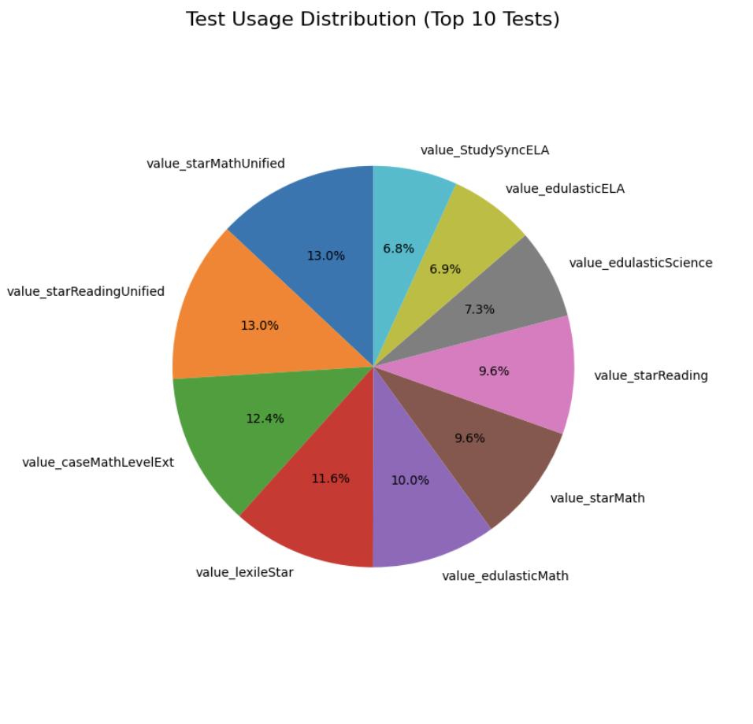
Data Visualization for most common exams
Notes:
Jessica
Notes:
We were able to create a few visualizations from our datasets. This one in particular is from student scores
As we can see here, we analyzed which test scores we have the most information on.
The original dataset had several dozen types of test scores, so for interpretability we are focusing on the top 10 tests from our dataset
Notably, value_starMathUnified and value_starReadingUnified make up about 13% each of the total scores, which suggests a significant emphasis on both subjects.

Slide 45
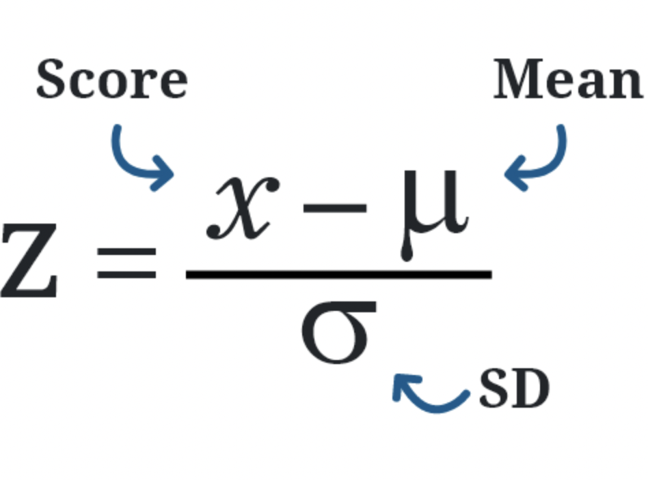
Calculating z-scores
Score: This is the value you are evaluating
Mean: The average of all the data points in the dataset
Standard Deviation: Measures how spread out the data is around the mean
Notes:
Zubeyda
Notes:
-We used the z-score formula to standardize all test scores:
z=Score−MeanStandard Deviationz = \frac{{\text{Score} - \text{Mean}}}{{\text{Standard Deviation}}}z=Standard DeviationScore−Mean​
This allowed us to normalize the dataset and ensure consistent analysis across different tests."

